Slide 1
Introduction to the Population Biology of Infectious Disease
BIOS27816: Population biology of infectious diseases of global health concern
UChicago Center in Paris
Paris, France
January 2024

Slide 2
Goals for this lecture
To explain what we’re doing here

Slide 3
Goals for this lecture
To explain what we’re doing here
To define “science”

Slide 4
Goals for this lecture
To explain what we’re doing here
To define “science”
To define “data”

Slide 5
Goals for this lecture
To explain what we’re doing here
To define “science”
To define “data”
To define “models”

Slide 6
Goals for this lecture
To explain what we’re doing here
To define “science”
To define “data”
To define “models”
To introduce many different types of models

Slide 7
Goals for this lecture
To explain what we’re doing here
To define “science”
To define “data”
To define “models”
To introduce many different types of models
Statistical

Slide 8
Goals for this lecture
To explain what we’re doing here
To define “science”
To define “data”
To define “models”
To introduce many different types of models
Statistical
Mathematical

Slide 9
Goals for this lecture
To explain what we’re doing here
To define “science”
To define “data”
To define “models”
To introduce many different types of models
Statistical
Mathematical
To explain the application of these models to the fields of:
Classical epidemiology
Population biology of infectious diseases

Slide 10
Goals for this lecture
To explain what we’re doing here

Slide 11
Goals for this lecture
To explain what we’re doing here

Slide 12
What is global health?

Slide 13
What is global health?
the health of the populations in the worldwide context (WHO 2006)
an area of study, research, and practice that places a priority on improving health and achieving equity in health for all people worldwide
focus on problems that transcend national borders or have a global political and economic impact are often emphasized (reduction of disparities, protection against global threats)
e.g. COVID (vaccination), polio eradication
Different from international health, the branch of public health focused on foreign aid efforts led by high income countries to improve health improve health in low and middle income countries (LMICs)

Slide 14
What is global health?
the health of the populations in the worldwide context (WHO 2006)
an area of study, research, and practice that places a priority on improving health and achieving equity in health for all people worldwide
focus on problems that transcend national borders or have a global political and economic impact are often emphasized (reduction of disparities, protection against global threats)
e.g. COVID (vaccination), polio eradication
Different from international health, the branch of public health focused on foreign aid efforts led by high income countries to improve health improve health in low- and middle-income countries (LMICs)

Slide 15
What are the major threats to global health? (e.g. globally, the leading causes of death)

Slide 18
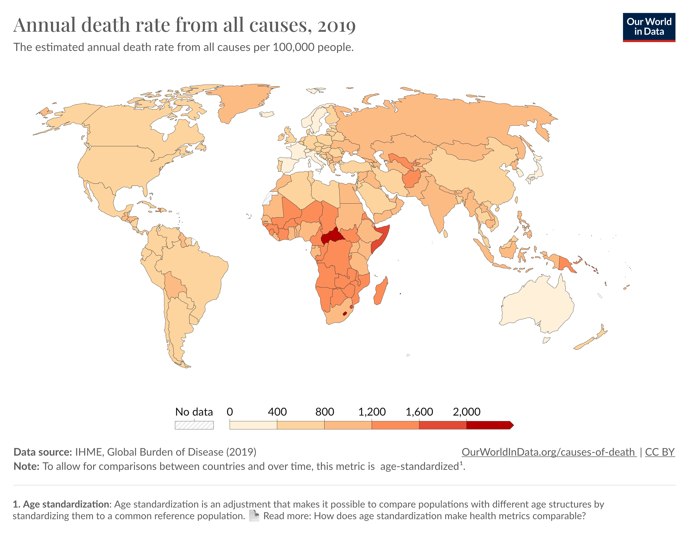
Global death rates are far from equitable.

Slide 19
Global death rates are far from equitable.
We’re here to learn how the field of ‘global health’ can intervene to reverse these trends.

Slide 20
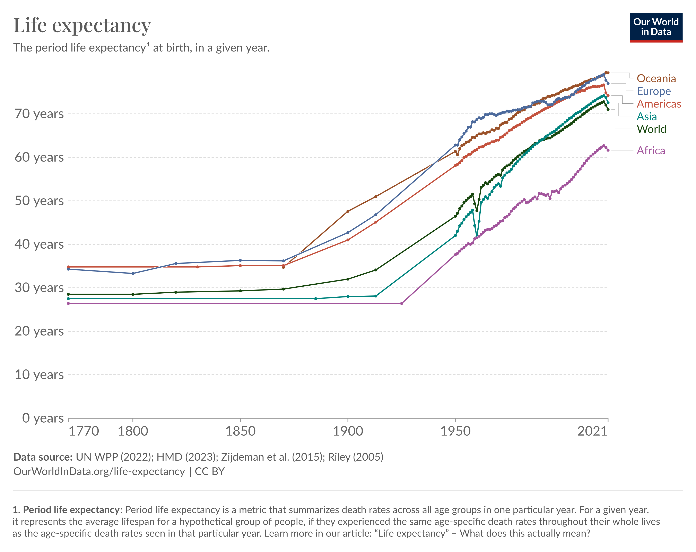

Slide 22
BIOS27816:
Population biology of infectious diseases of global health concern

Slide 23
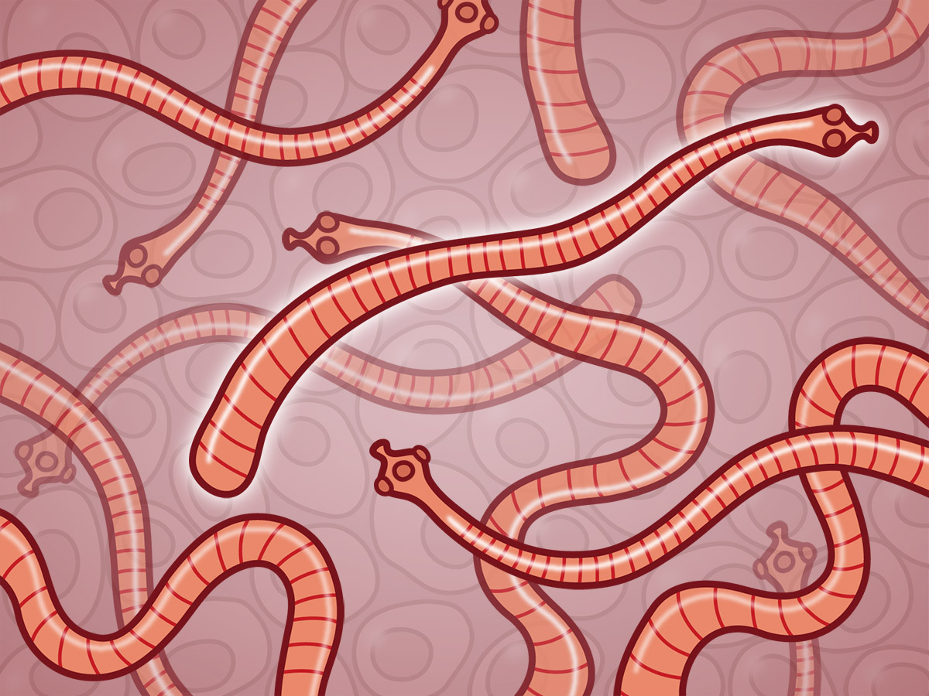
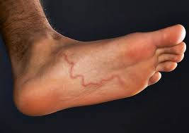
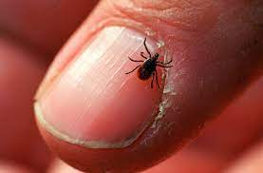
Parasites and Pathogens
Parasite: an organism that lives in or on another organism and benefits at the expense of others.
Ex: helminths (parasitic worms: tapeworms, roundworms, hookworms), ectoparasites (ticks, fleas)
Notes:
Parasite isPathogen

Slide 24
Parasites and Pathogens
Parasite: an organism that lives in or on another organism and benefits at the expense of others.
Ex: helminths (parasitic worms: tapeworms, roundworms, hookworms), ectoparasites (ticks, fleas)
Pathogen: a microorganism that can cause disease
Ex: bacterium, virus, protozoan
Notes:
Parasite isPathogen

Slide 25
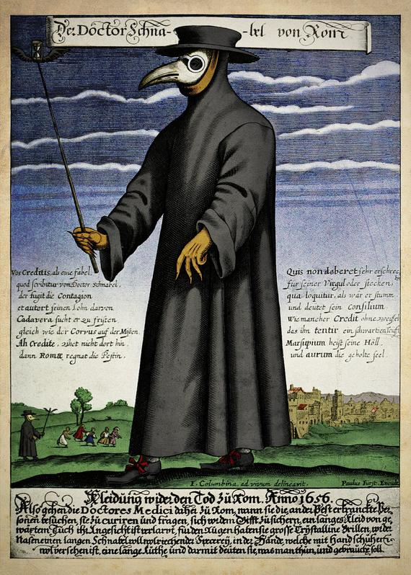
Parasites and Pathogens
Parasite: an organism that lives in or on another organism and benefits at the expense of others.
Ex: helminths (parasitic worms: tapeworms, roundworms, hookworms), ectoparasites (ticks, fleas)
Pathogen: a microorganism that can cause disease
Ex: bacterium, virus, protozoan
Pathogen: Yersinia pestis
Disease: Plague
Notes:
Parasite isPathogen

Slide 26
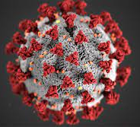
Parasites and Pathogens
Parasite: an organism that lives in or on another organism and benefits at the expense of others.
Ex: helminths (parasitic worms: tapeworms, roundworms, hookworms), ectoparasites (ticks, fleas)
Pathogen: a microorganism that can cause disease
Ex: bacterium, virus, protozoan
Pathogen: Yersinia pestis
Disease: Plague
Pathogen: SARS-CoV-2
Disease: COVID-19
Notes:
Parasite isPathogen

Slide 27
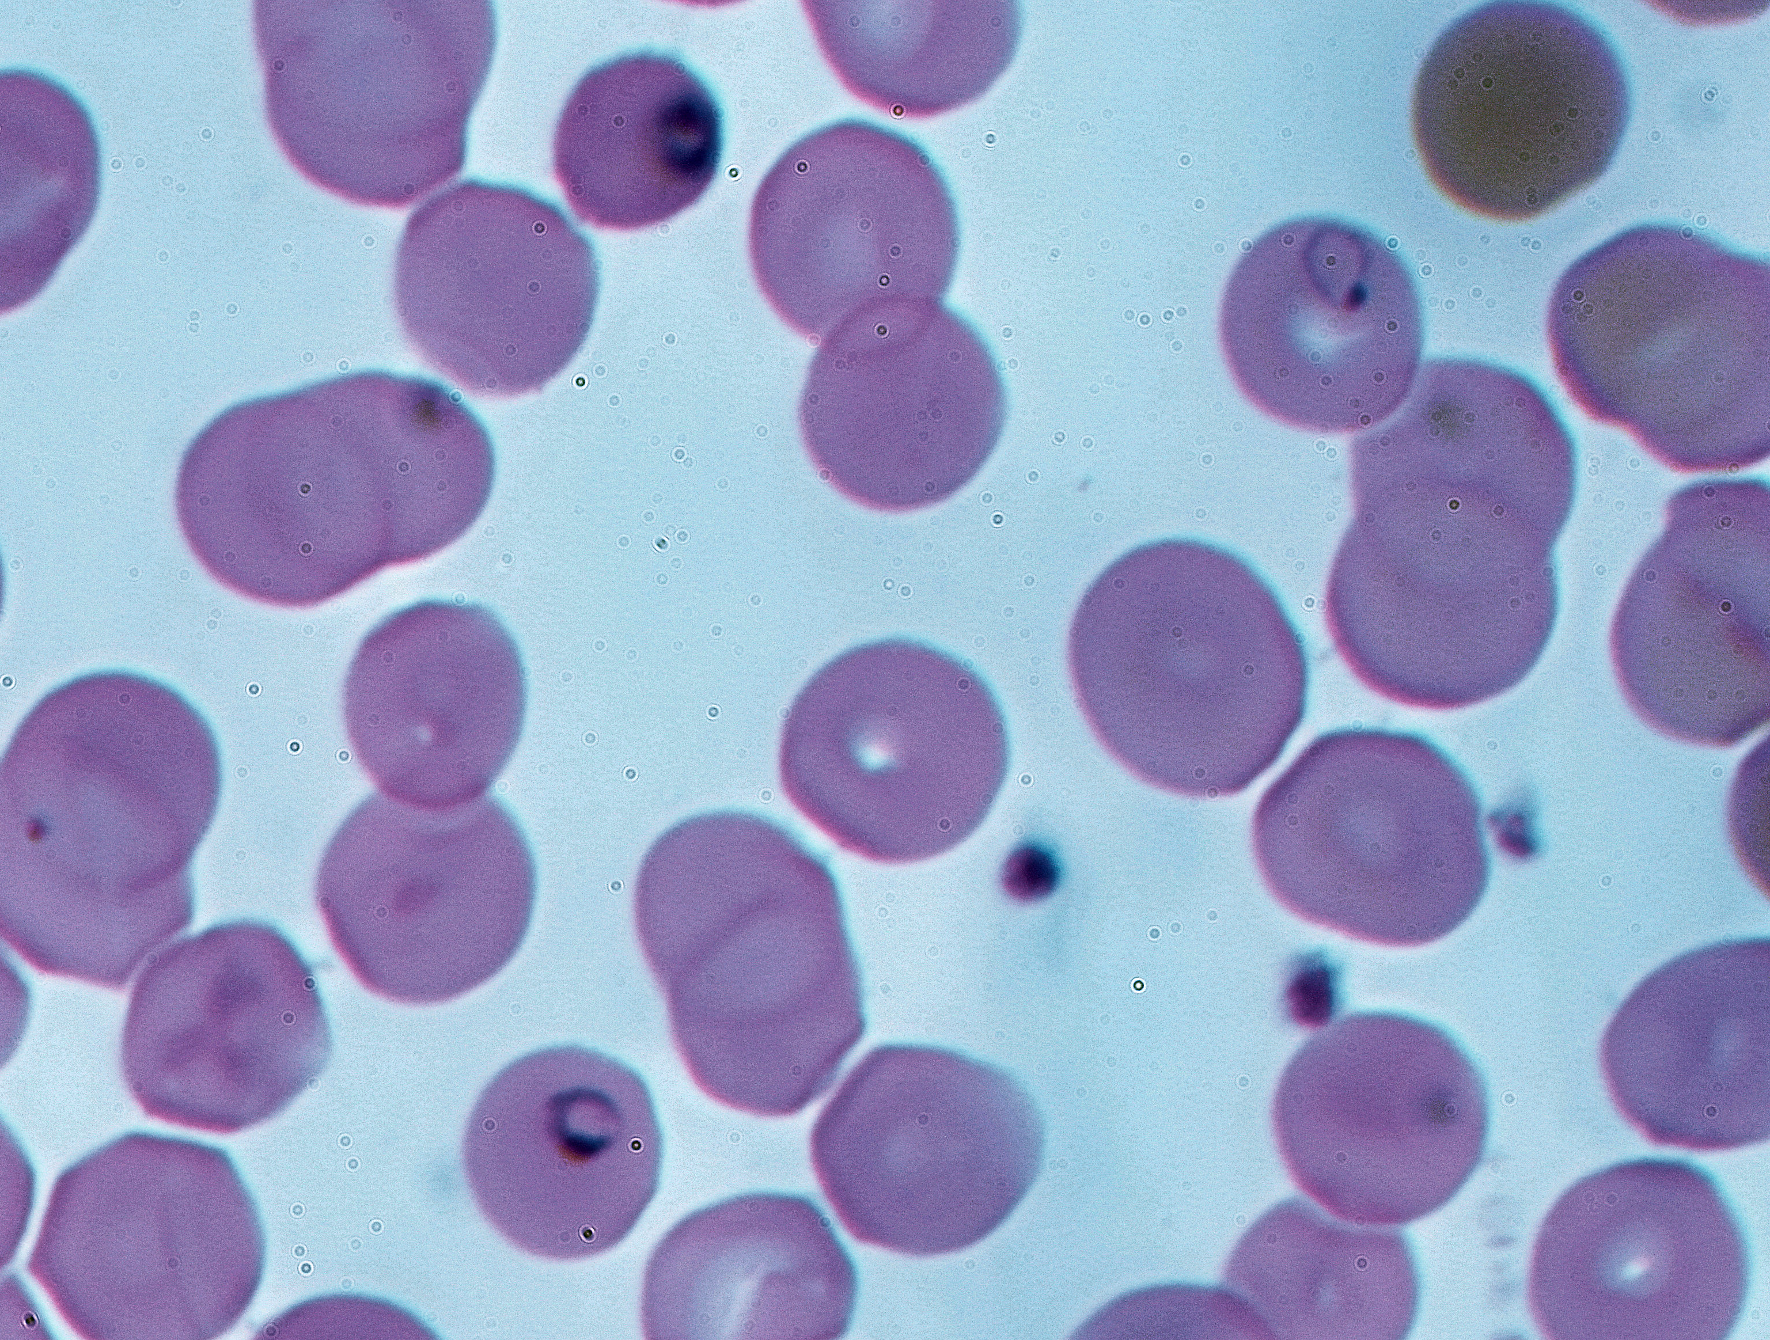
Parasites and Pathogens
Parasite: an organism that lives in or on another organism and benefits at the expense of others.
Ex: helminths (parasitic worms: tapeworms, roundworms, hookworms), ectoparasites (ticks, fleas)
Pathogen: a microorganism that can cause disease
Ex: bacterium, virus, protozoan
Pathogen: Yersinia pestis
Disease: Plague
Pathogen: Plasmodium falciparum, P. vivax, P. malariae, P. ovale, P. knowlesi
Disease: malaria
Pathogen: SARS-CoV-2
Disease: COVID-19
Notes:
Parasite isPathogen

Slide 28
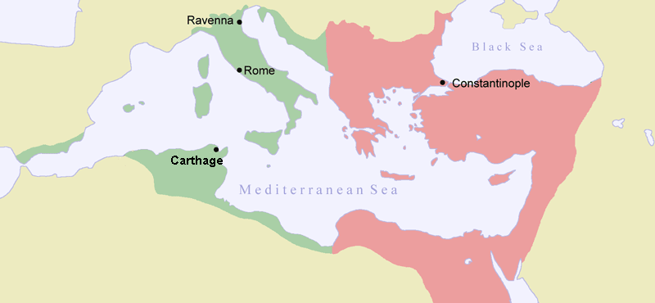
Parasites and pathogens have shaped human history.
Plague of Justinian (541-549 AD)
First historically recorded pandemic of Yersinia pestis
Launched the ‘first plague pandemic’ resulting in the deaths of 15-100 million people, 25-60% of Europe’s population at the time
Notes:
Parasite is an organism that lives in or on another organism and benefits at the expense of others.
Pathogen

Slide 29
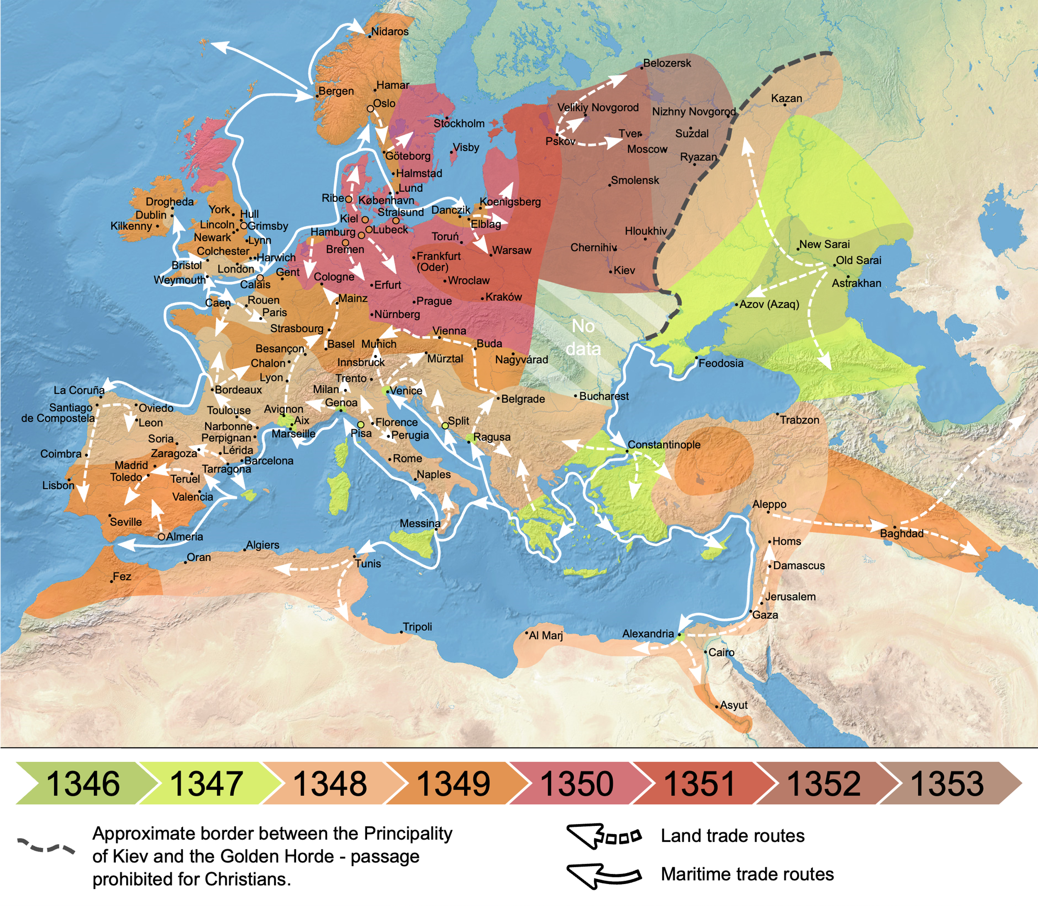
Parasites and pathogens have shaped human history.
Plague of Justinian (541-549 AD)
Black Death (1346-1353 AD)
Most fatal pandemic in human history, resulting in deaths of 75-200 million people
Killed 30-60% of Europe’s population at the time; 17-54% of global population
Notes:
By Flappiefh - Own work from:Natural Earth ;The origin and early spread of the Black Death in Italy: first evidence of plague victims from 14th-century Liguria (northern Italy) maps by O.J. Benedictow., CC BY-SA 4.0, https://commons.wikimedia.org/w/index.php?curid=66468361

Slide 30
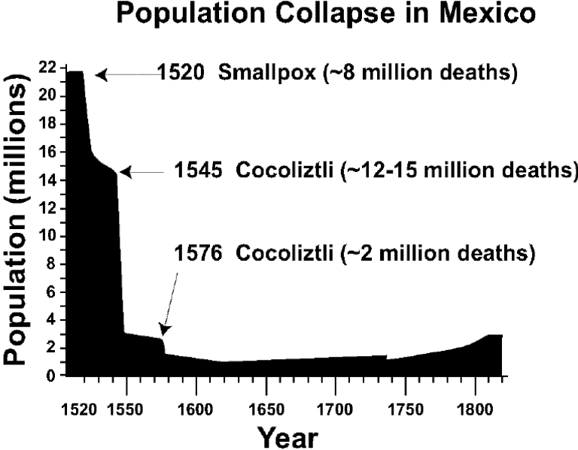
Parasites and pathogens have shaped human history.
Plague of Justinian (541-549 AD)
Black Death (1346-1353 AD)
Cocoliztli (1545-1548)
Pathogen still unknown! Maybe viral hemorrhagic fever, maybe bacterium
Killed 80% of the population of Mexico
Notes:
By Flappiefh - Own work from:Natural Earth ;The origin and early spread of the Black Death in Italy: first evidence of plague victims from 14th-century Liguria (northern Italy) maps by O.J. Benedictow., CC BY-SA 4.0, https://commons.wikimedia.org/w/index.php?curid=66468361

Slide 31
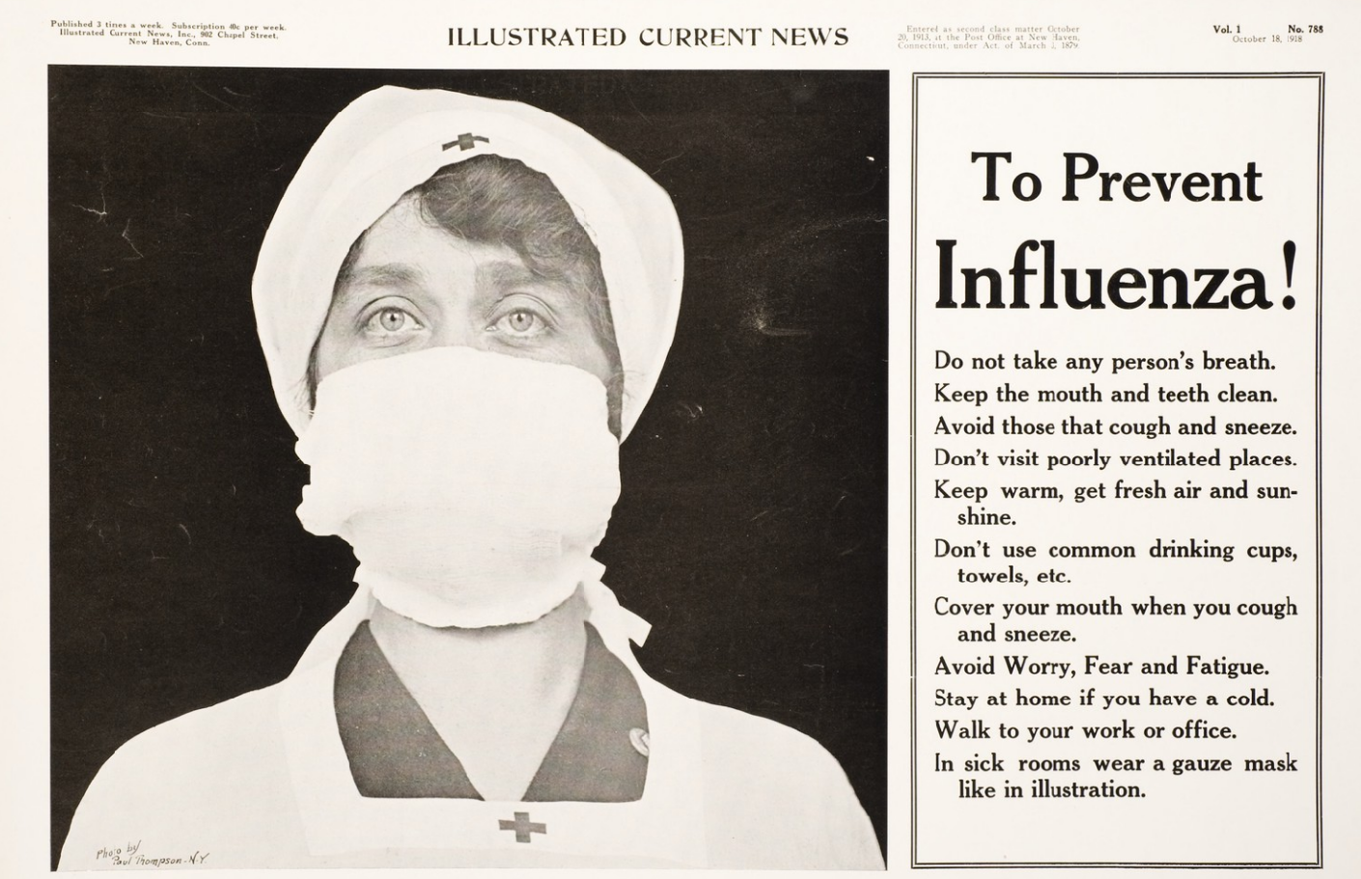
Parasites and pathogens have shaped human history.
Plague of Justinian (541-549 AD)
Black Death (1346-1353 AD)
Cocoliztli (1545-1548)
Spanish Influenza (1918-1920)
17-100 million deaths worldwide.
1-5% of global population
2nd-most devastating pandemic in history (after Black Death)
Notes:
The pandemic broke out near the end of World War I, when wartime censors in the belligerent countries suppressed bad news to maintain morale, but newspapers freely reported the outbreak in neutral Spain, creating a false impression of Spain as the epicenter and leading to the "Spanish flu" misnomer.[

Slide 32
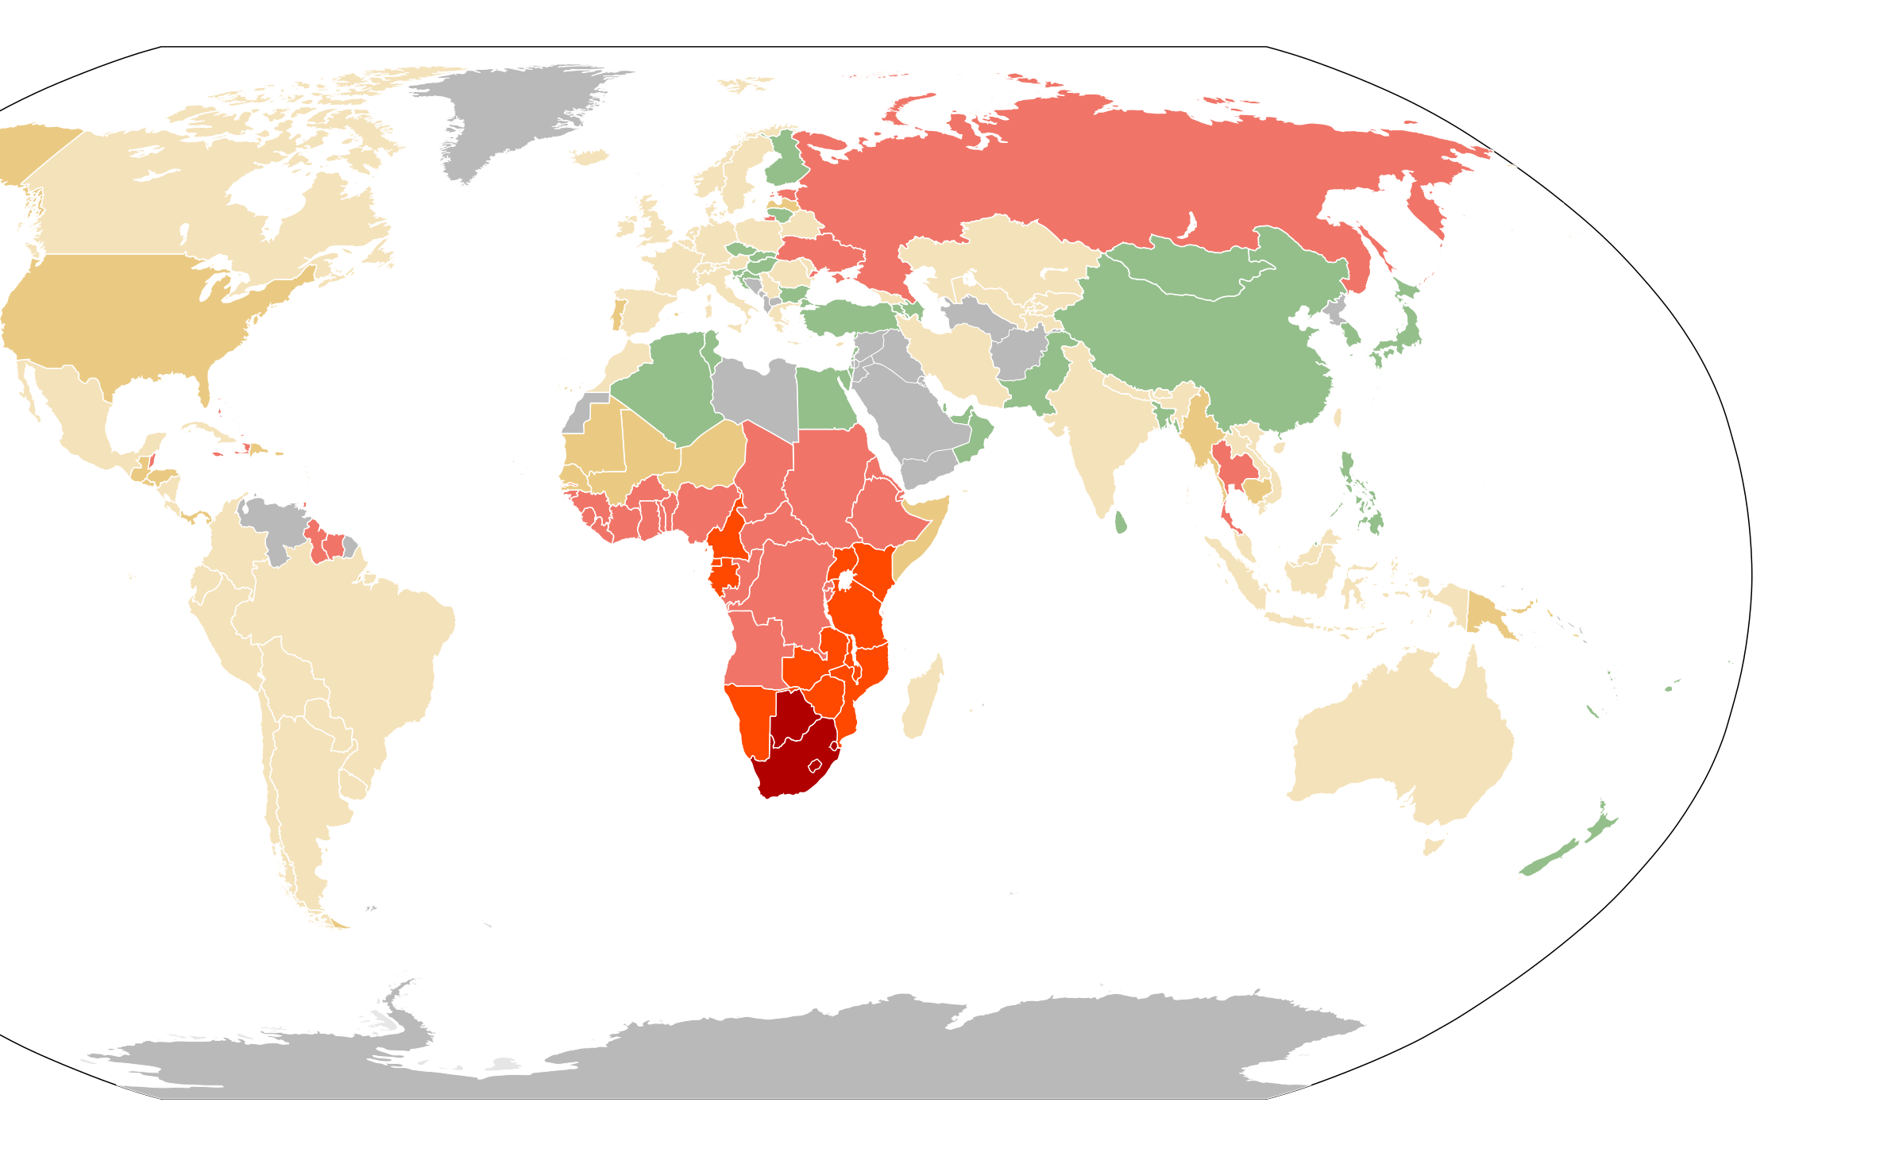
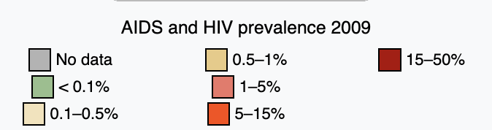
Parasites and pathogens have shaped human history.
Plague of Justinian (541-549 AD)
Black Death (1346-1353 AD)
Cocoliztli (1545-1548)
Spanish Influenza (1918-1920)
HIV (~1960-now)
>40 million deaths and counting
Prevalence still >20% in some countries in southern Africa

Slide 33
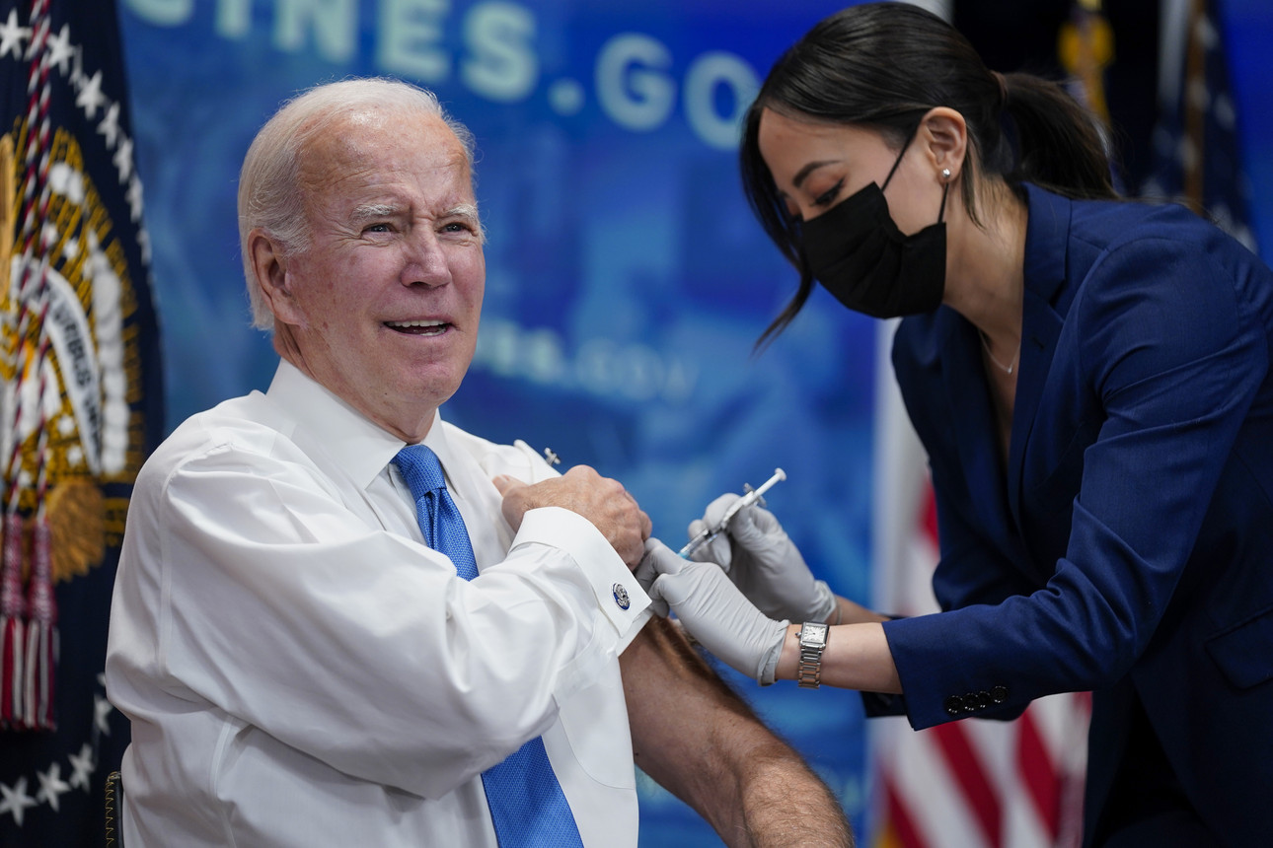
Parasites and pathogens have shaped human history.
Plague of Justinian (541-549 AD)
Black Death (1346-1353 AD)
Cocoliztli (1545-1548)
Spanish Influenza (1918-1920)
HIV (~1960-now)
COVID-19 (2019-now)
~7-30 million deaths worldwide
~0.1-0.4% of population
Notes:
According to a UNAIDS dataset sourced from the World Bank, in 2019 the HIV prevalence rate for adults aged 15 to 49 was 27% in Eswatini (Swaziland), 25% in Lesotho, 25% in Botswana and 19% in South Africa.^{[1]}

Slide 34
Parasites and pathogens have also shaped human DNA.
Notes:
The way in which sickle cell protects against malaria is attributed to several different things. One of the more common explanations is that the sickle hemoglobin inhibits the plasmodium parasite from infecting the red blood cells which reduces the number of malaria parasites to infect the host. Another factor is the production of heme oxygenase-1 (HO-1) enzyme, which is highly present in the sickle hemoglobin. This enzyme produces carbon monoxide which has been proven to protect against cerebral malaria
Normally, a person inherits two copies of the gene that produces beta-globin, a protein needed to produce normal hemoglobin (hemoglobin A, genotype AA). A person with sickle cell trait inherits one normal allele and one abnormal allele encoding hemoglobin S (hemoglobin genotype AS)
The sickle cell trait can be used to demonstrate the concepts of co-dominance and incomplete dominance. An individual with the sickle cell trait shows incomplete dominance when the shape of the red blood cell is considered. This is because the sickling happens only at low oxygen concentrations. With regards to the actual concentration of hemoglobin in the circulating cells, the alleles demonstrate co-dominance as both 'normal' and mutant forms co-exist in the bloodstream. Thus it is an ambiguous condition showing both incomplete dominance and co-dominance
2021, there were an estimated 247 million cases of malaria worldwide.
The estimated number of malaria deaths stood at 619 000 in 2021.
The WHO African Region carries a disproportionately high share of the global malaria burden. In 2021, the region was home to 95% of malaria cases and 96% of malaria deaths. Children under 5 accounted for about 80% of all malaria deaths in the Region.

Slide 35
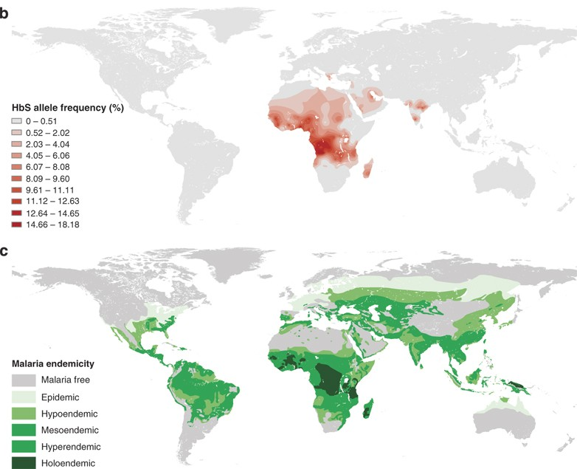
Parasites and pathogens have also shaped human DNA.
Sickle cell anemia
The HbS allele confers resistance to malaria but also results in sickle cell anemia when homozygous.
Natural selection has favored this trait in malaria-endemic regions of the planet.
As of 2021, WHO estimates 247 million malaria cases worldwide and >600,000 deaths, 95% in Africa.
Children <5 account for 80% of malaria deaths.
Piel et al 2010. Nature Communications.
Notes:
The way in which sickle cell protects against malaria is attributed to several different things. One of the more common explanations is that the sickle hemoglobin inhibits the plasmodium parasite from infecting the red blood cells which reduces the number of malaria parasites to infect the host. Another factor is the production of heme oxygenase-1 (HO-1) enzyme, which is highly present in the sickle hemoglobin. This enzyme produces carbon monoxide which has been proven to protect against cerebral malaria
Normally, a person inherits two copies of the gene that produces beta-globin, a protein needed to produce normal hemoglobin (hemoglobin A, genotype AA). A person with sickle cell trait inherits one normal allele and one abnormal allele encoding hemoglobin S (hemoglobin genotype AS)
The sickle cell trait can be used to demonstrate the concepts of co-dominance and incomplete dominance. An individual with the sickle cell trait shows incomplete dominance when the shape of the red blood cell is considered. This is because the sickling happens only at low oxygen concentrations. With regards to the actual concentration of hemoglobin in the circulating cells, the alleles demonstrate co-dominance as both 'normal' and mutant forms co-exist in the bloodstream. Thus it is an ambiguous condition showing both incomplete dominance and co-dominance
2021, there were an estimated 247 million cases of malaria worldwide.
The estimated number of malaria deaths stood at 619 000 in 2021.
The WHO African Region carries a disproportionately high share of the global malaria burden. In 2021, the region was home to 95% of malaria cases and 96% of malaria deaths. Children under 5 accounted for about 80% of all malaria deaths in the Region.

Slide 36
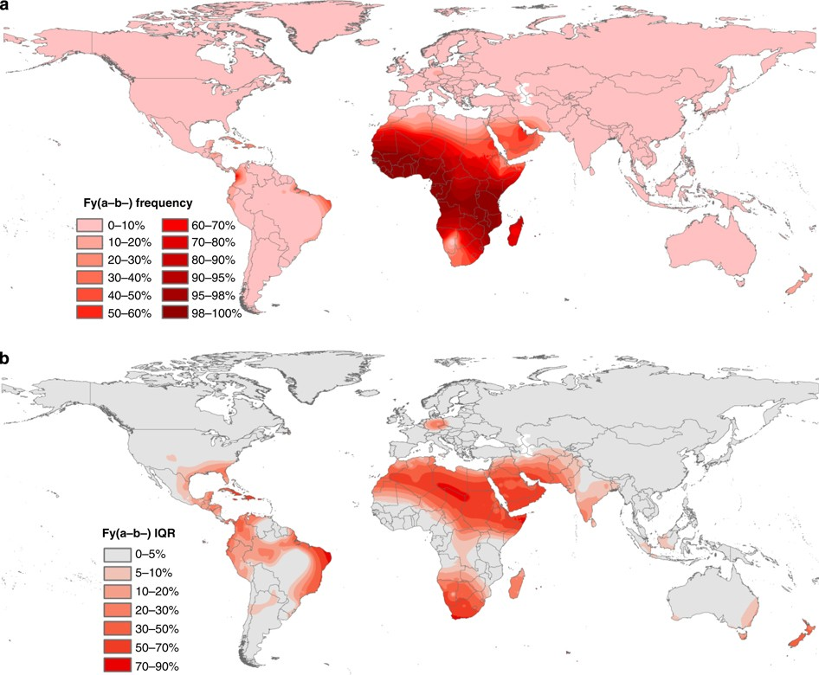
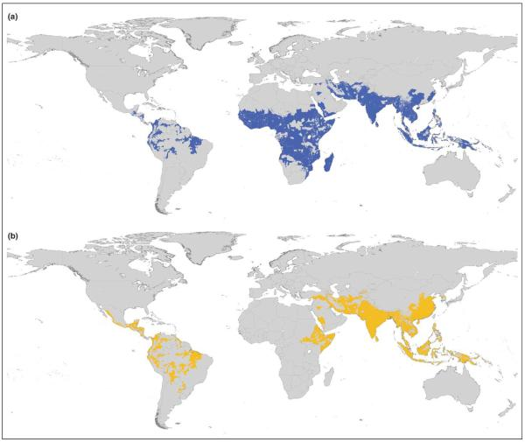
Parasites and pathogens have also shaped human DNA.
Duffy antigen
Modeled distribution of Duffy-negative human population
Distribution Plasmodium falciparum
Distribution Plasmodium vivax
Guerra et al. 2006. Trends in Parasitology
Howes et al 2011. Nature Communications.

Slide 37
We’ll use population biology to try to understand their transmission.

Slide 38
What is science?

Slide 39
What is science?
the systematic observation of natural events and conditions in order to discover facts about them and to formulate laws and principles based on these facts.
– Academic Press Dictionary of Science & Technology

Slide 40
What is science?
the systematic observation of natural events and conditions in order to discover facts about them and to formulate laws and principles based on these facts.
– Academic Press Dictionary of Science & Technology

Slide 41
Observations and Laws and Principles

Slide 42
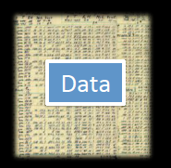
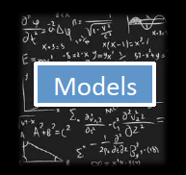
Data and Models
Models

Slide 43
Data and Models
What are data?

Slide 44
Data and Models
What are data?
Backbone of science
Evidence to support a claim

Slide 45
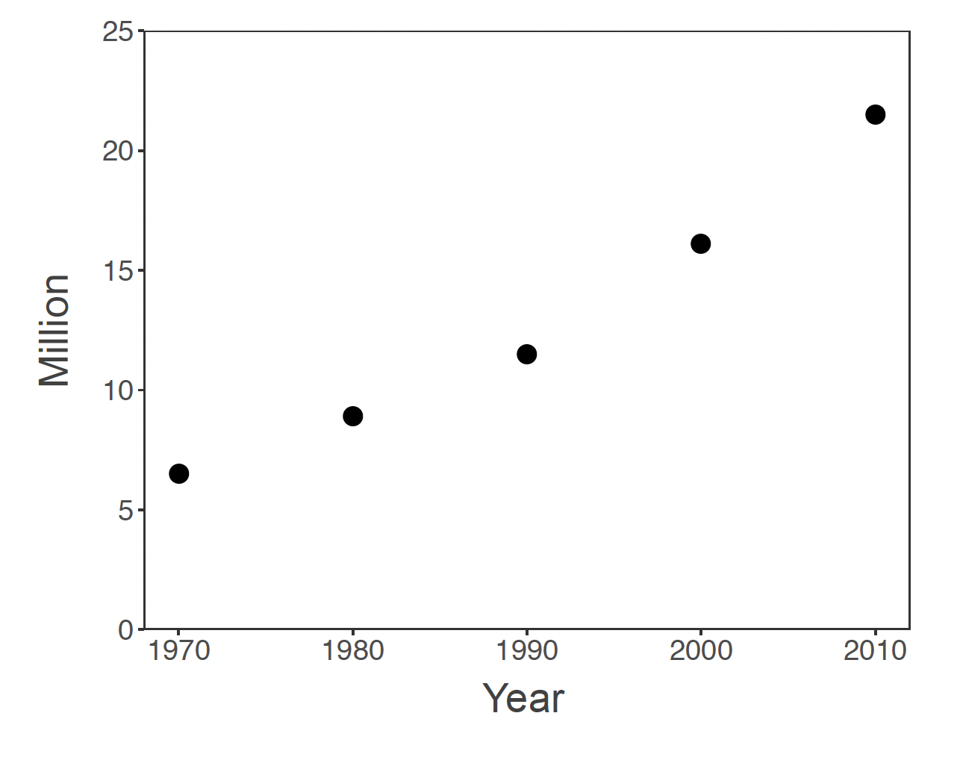
Are these data?

Slide 46
Are these data?
What do we need to make these data?

Slide 47
Are these data?

Slide 48
Are these data?

Slide 49
Are these data?

Slide 50
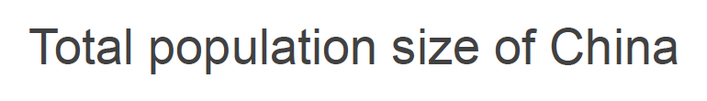
Are these data?

Slide 51
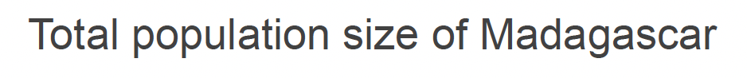
Are these data?

Slide 52
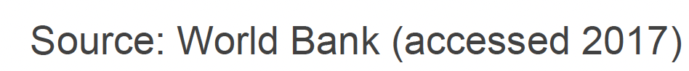
Are these data?

Slide 53
What are data?
A relationship between at least two variables
x: explanatory, control, driver, independent variable(s)
y: response, dependent variable(s)
x and y should be clearly defined
with respect to the question!
Backbone of science
Evidence to support a claim

Slide 54
What are data?
A relationship between at least two variables
x: explanatory, control, driver, independent variable(s)
y: response, dependent variable(s)
x and y should be clearly defined
with respect to the question!
Backbone of science
Evidence to support a claim

Slide 55
What are data?
A relationship between at least two variables
x: explanatory, control, driver, independent variable(s)
y: response, dependent variable(s)
x and y should be clearly defined
with respect to the question!
Evidence to support a claim

Slide 56
Data provide evidence to support a claim.
Backbone of science
CLAIM: The population size of Madagascar has increased throughout the past 50 years

Slide 57
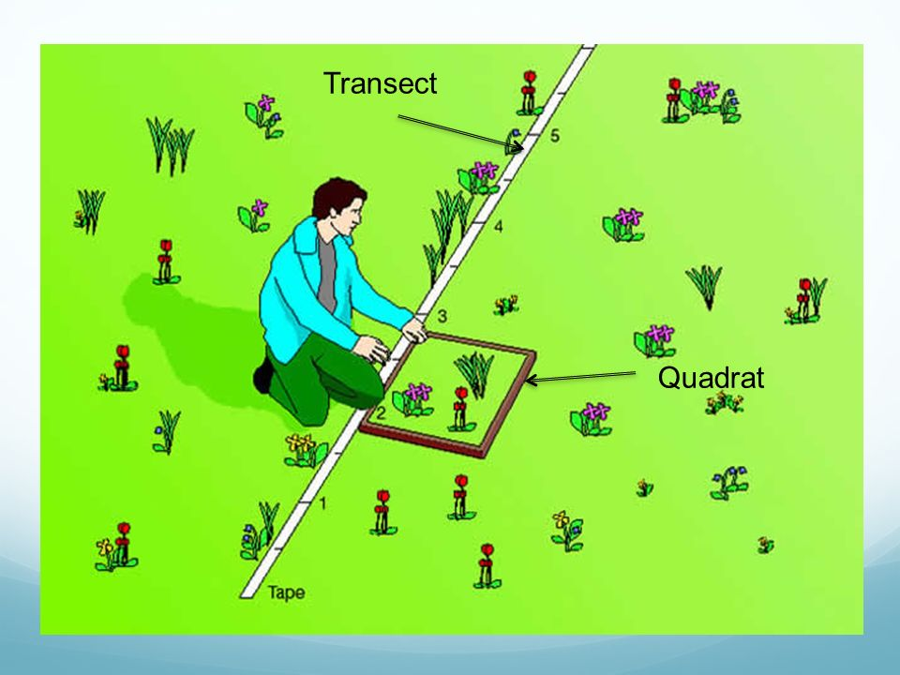
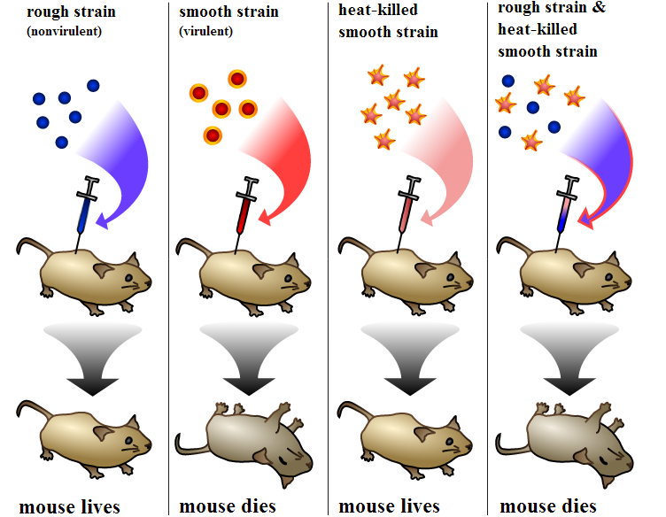
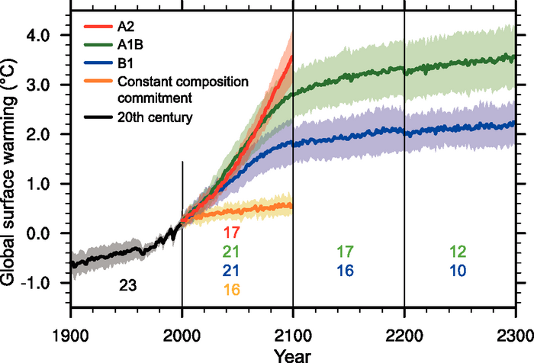
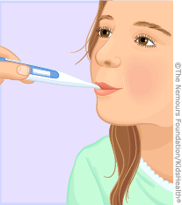
Data: Sources of x and y
Observational | Experimental | Simulated
- Just measure x and y | - Interfere with x or the relationship between x and y | - Create a relationship between x and y
Empirical data

Slide 58
Data: Types
Numerical
Categorical

Slide 59
Data: Types
Numerical
A variable is numerical when you can transform it with mathematical operation
Examples?
Categorical

Slide 60
Data: Types
Numerical
A variable is numerical when you can transform it with mathematical operation
Examples:
Integer, real number, multi-dimensional number
Categorical

Slide 61
Data: Types
Numerical
A variable is numerical when you can transform it with mathematical operation
Examples:
Integer, real number, multi-dimensional number
Categorical
A variable is categorical when it is not numerical but a categorical can be numerical?
Examples?

Slide 62
Data: Types
Numerical
A variable is numerical when you can transform it with mathematical operation
Examples:
Integer, real number, multi-dimensional number
Categorical
A variable is categorical when it is not numerical but a categorical can be numerical?
Examples:
Colors, (blood) types, species name

Slide 63
Data: Things to consider
Data acquisition

Slide 64
Data: Things to consider
Data acquisition
Impossible, example?

Slide 65
Data: Things to consider
Data acquisition
Impossible, example?
Theoretically possible but practically unfeasible, examples?

Slide 66
Data: Things to consider
Data acquisition
Impossible, example?
Theoretically possible but practically unfeasible, examples?
Data quality and quantity
In practice there is always a trade-off

Slide 67
Data: Things to consider
Data acquisition
Impossible, example?
Theoretically possible but practically unfeasible, examples?
Data quality and quantity
In practice there is always a trade-off
Example: monetary cost, human effort -> power analysis, sampling design etc.

Slide 68
Data: Things to consider
Data acquisition
Impossible, example?
Theoretically possible but practically unfeasible, examples?
Data quality and quantity
In practice there is always a trade-off
Example: monetary cost, human effort -> power analysis, sampling design etc.
Reproducibility

Slide 69
Data: Things to consider
Data acquisition
Impossible, example?
Theoretically possible but practically unfeasible, examples?
Data quality and quantity
In practice there is always a trade-off
Example: monetary cost, human effort -> power analysis, sampling design etc.
Reproducibility
Measurement errors

Slide 70
Data: Things to consider
Data acquisition
Impossible, example?
Theoretically possible but practically unfeasible, examples?
Data quality and quantity
In practice there is always a trade-off
Example: monetary cost, human effort -> power analysis, sampling design etc.
Reproducibility
Measurement errors
Examples?

Slide 72
Data and Models
Models

Slide 73
Data and Models
Models
What is a model?

Slide 74
What is science?
the systematic observation of natural events and conditions in order to discover facts about them and to formulate laws and principles based on these facts.
– Academic Press Dictionary of Science & Technology

Slide 75
Laws and Principles
Theory General
Model
Hypothesis Specific

Slide 76
Laws and Principles
Theory General
Model
Hypothesis Specific
a declaration to explain a phenomenon

Slide 77
Laws and Principles
Theory General
Model
Hypothesis Specific
a declaration to explain a phenomenon
an abstract representation of a phenomenon

Slide 78
Laws and Principles
Theory General
Model
Hypothesis Specific
a declaration to explain a phenomenon
an abstract representation of a phenomenon
a testable declaration that is derived from a theory

Slide 79

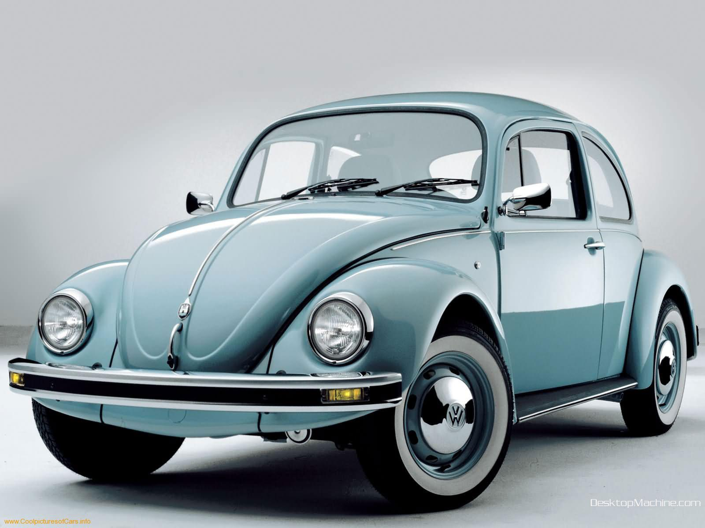
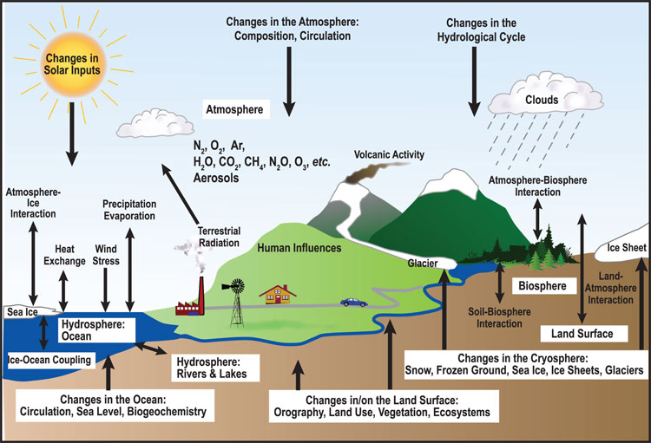
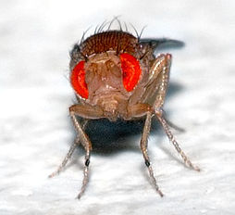
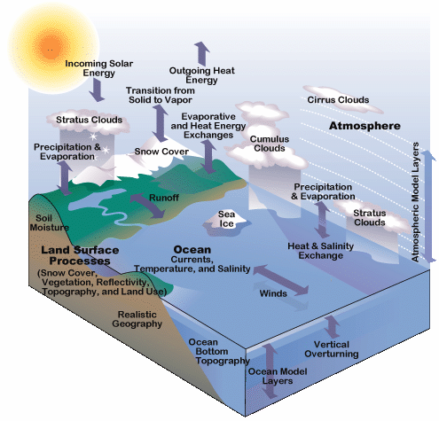
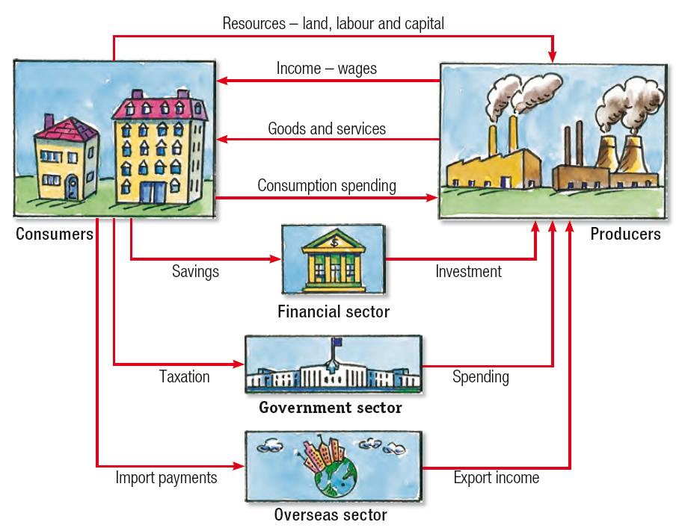
Models: many types
Human
Car
Ecosystem
Ecology & Evolution
Climate
Economy

Slide 80
When you make a model,
you include the
elements that you feel are most important to explain a phenomenon.

Slide 81
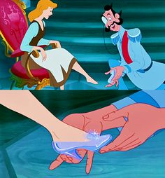
When you make a model,
you include the
elements that you feel are most important to explain a phenomenon.
Generally, we try to make models
that can reproduce real-world data

Slide 82
When you make a model,
you include the
elements that you feel are most important to explain a phenomenon.
Generally, we try to make models
that can reproduce real-world data
We can distinguish between statistical and mechanistic models

Slide 83
Statistical vs. Mathematical Model
The choice depends on the research question!

Slide 84
Statistical Models
Goal: To rigorously assess the strength of relationship between x and y

Slide 85
Statistical Models
Goal: To rigorously assess the strength of relationship between x and y
Find a significant relationship using a p-value as a measure of relationship strength

Slide 86
Statistical Models
Goal: To rigorously assess the strength of relationship between x and y
Find a significant relationship using a p-value as a measure of relationship strength
Statistical models can demonstrate correlations.

Slide 87
Statistical Models
Goal: To rigorously assess the strength of relationship between x and y (describe patterns)
Find a significant relationship using a p-value as a measure of relationship strength
Statistical models can demonstrate correlations.
Steps:
Formulate a research question
Formulate a hypothesis
Develop a model to demonstrate your hypothesis.
Collect data (required!!!)
Evaluate hypothesis with appropriate statistical tools
t-test, Chi-square, ANOVA
Ordination (PCA)
Regression (LM, GLM, GLMM, GAM)

Slide 88
1. Example Question: What is the trajectory of Malagasy population size through time?
Source: World Bank

Slide 89
1. Example Question: What is the trajectory of Malagasy population size through time?
2. Hypothesis: Malagasy population size increases with time
Source: World Bank

Slide 90
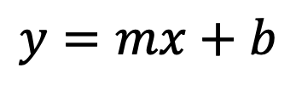
1. Example Question: What is the trajectory of Malagasy population size through time?
2. Hypothesis: Malagasy population size increases with time
3. Statistical Model:
$$y=mx+b$$
Linear Regression
Source: World Bank

Slide 91
1. Example Question: What is the trajectory of Malagasy population size through time?
4. Data:
2. Hypothesis: Malagasy population size increases with time
3. Statistical Model:
$$y=mx+b$$
Linear Regression
Source: World Bank

Slide 92
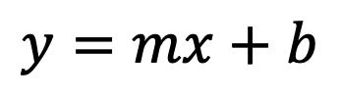
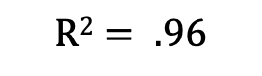

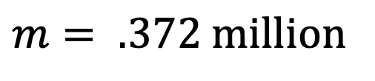
1. Example Question: What is the trajectory of Malagasy population size through time?
4. Data:
2. Hypothesis: Malagasy population size increases with time
3. Statistical Model:
5. Evaluation
Linear Regression
$$y=mx+b$$
$$m= .372 million$$
$$p= .003$$
$$R2= .96$$
What can we conclude from this fitted model?
Source: World Bank

Slide 93

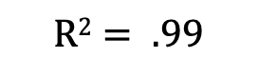

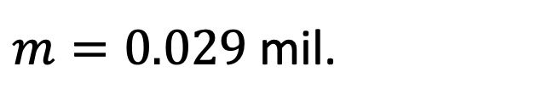
1. Example Question: What is the trajectory of Malagasy population size through time?
6. Adapt your model and re-evaluate:
Exponential Regression
$$y=e^{mx+b}$$
Exponential Regression
$m=0.029$ mil.
$$p<.001$$
$$R2= .99$$
What can we conclude from this fitted model?
Source: World Bank

Slide 94
Statistical Models: Beware!
Statistical models and tests are based on specific assumptions
data normally distributed
x and y independent

Slide 95
Statistical Models: Beware!
Statistical models and tests are based on specific assumptions
data normally distributed
x and y independent
Assessing a model means you need to make sure the assumptions are not violated.

Slide 96

Statistical Models: Beware!
Statistical models and tests are based on specific assumptions
data normally distributed
x and y independent
Assessing a model means you need to make sure the assumptions are not violated.
There are so many statistical models…

Slide 97
Statistical vs. Mathematical Model
The choice depends on the research question!

Slide 98
Mechanistic Models
Goal: To demonstrate the processes that underlie a relationship between x and y

Slide 99
Mechanistic Models
Goal: To demonstrate the processes that underlie a relationship between x and y
Find a significant relationship using a p-value as a measure of relationship strength.

Slide 100
Mechanistic Models
Goal: To demonstrate the processes that underlie a relationship between x and y
Find a significant relationship using a p-value as a measure of relationship strength
Mechanistic models can demonstrate causation.

Slide 101
Mechanistic Models
Goal: To demonstrate the processes that underlie a relationship between x and y
Find a significant relationship using a p-value as a measure of relationship strength
Mechanistic models can demonstrate causation.
Steps:
Formulate a research question
Formulate a hypothesis
Develop a model to demonstrate your hypothesis.
Collect data (for certain questions)
Evaluate the extent to which your model-simulated data matches that from the real world.

Slide 102
1. Example Question: How does Malagasy population size change with time?
2. Hypothesis: Malagasy population size increases because people are having children.
Can you think of an alternative hypothesis?
Source: World Bank

Slide 103
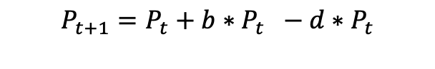
1. Example Question: How does Malagasy population size change with time?
2. Hypothesis: Malagasy population size increases because people are having children.
3. Mechanistic Model:
Population
birth
death
$$P_{t+1}=P_{t}+b∗P_{t} −d∗P_{t}$$
$$P_{t+1}=P_{t}+r∗P_{t}$$
Source: World Bank

Slide 104
1. Example Question: How does Malagasy population size change with time?
2. Hypothesis: Malagasy population size increases because people are having children.
3. Mechanistic Model:
4. Data:
Population
birth
death
$$P_{t+1}=P_{t}+b∗P_{t} −d∗P_{t}$$
$$P_{t+1}=P_{t}+r∗P_{t}$$
Source: World Bank

Slide 105
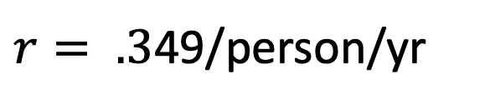
1. Example Question: How does Malagasy population size change with time?
2. Hypothesis: Malagasy population size increases because people are having children.
3. Mechanistic Model:
5. Evaluation:
4. Data:
Population
birth
death
$r= .3$49/person/yr
What can we conclude from this fitted model?

Slide 106
Mechanistic Models: Beware!
Parameters used in the mechanistic models sometimes are not measurable!

Slide 107
Mechanistic Models: Beware!
Parameters used in the mechanistic models sometimes are not measurable!
Simulations can be computationally intensive

Slide 108
Mechanistic Models: Beware!
Parameters used in the mechanistic models sometimes are not measurable!
Simulations can be computationally intensive
Advances in computational power often inspire development of more complex models which are not necessarily better

Slide 109
Mechanistic Models: Beware!
Parameters used in the mechanistic models sometimes are not measurable!
Simulations can be computationally intensive
Advances in computational power often inspire development of more complex models which are not necessarily better
“All models are wrong but some are useful…”
-George Box

Slide 110
Mechanistic Models: Beware!
Parameters used in the mechanistic models sometimes are not measurable!
Simulations can be computationally intensive
Advances in computational power often inspire development of more complex models which are not necessarily better
“All models are wrong but some are useful…”
-George Box
We use models to both predict and explain.

Slide 111
It is ideal when statistical and mechanistic models meet:
Mechanistic model
Process
Pattern
Statistical model

Slide 112
Parasites and pathogens have also shaped hus:an history.
Models and Data through the ages:
Parasites and pathogens have shaped human history.
But we have not always known they were responsible for disease!
Notes:
Parasite isPathogen

Slide 113
Models and Data through the ages:
What is responsible for disease?
Four Humors: Hippocrates (c. 400 BC) wrote that disease results from an imbalance of the four humors
Notes:
Parasite isPathogen

Slide 114
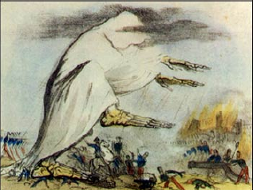
Models and Data through the ages:
What is responsible for disease?
Four Humors: Hippocrates (c. 400 BC) wrote that disease results from an imbalance of the four humors
Miasmatic Theory: Extension of Hippocrates that lasted through the 1800s – idea that disease was caused by bad air. Popularized by Florence Nightengale
Notes:
Parasite isPathogen

Slide 115
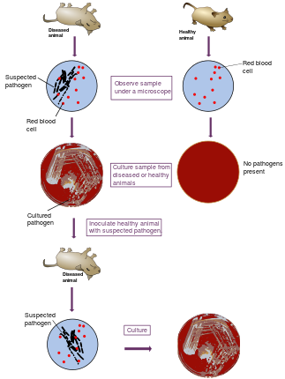
Models and Data through the ages:
What is responsible for disease?
Four Humors: Hippocrates (c. 400 BC) wrote that disease results from an imbalance of the four humors
Miasmatic Theory: Extension of Hippocrates that lasted through the 1800s – idea that disease was caused by bad air.
Popularized by Florence Nightengale
Germ Theory of Disease: Idea that disease results from germs
Leuwenhoek’s microscope (1675)
Koch’s postulates (1890)
Notes:
Parasite isPathogen

Slide 116
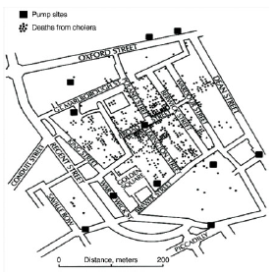
Models and Data through the ages:
What is responsible for disease?
Four Humors: Hippocrates (c. 400 BC) wrote that disease results from an imbalance of the four humors
Miasmatic Theory: Extension of Hippocrates that lasted through the 1800s – idea that disease was caused by bad air.
Popularized by Florence Nightengale
Germ Theory of Disease: Idea that disease results from germs
Leuwenhoek’s microscope (1675)
Koch’s postulates (1890)
Classic epidemiology
Risk factors for disease = John Snow (1854)
Notes:
Parasite isPathogen

Slide 117
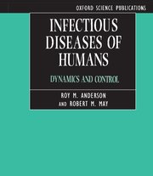
Models and Data through the ages:
Four Humors: Hippocrates (c. 400 BC) wrote that disease results from an imbalance of the four humors
Miasmatic Theory: Extension of Hippocrates that lasted through the 1800s – idea that disease was caused by bad air.
Popularized by Florence Nightengale
Germ Theory of Disease: Idea that disease results from germs
Leuwenhoek’s microscope (1675)
Koch’s postulates (1890)
Classic epidemiology
Risk factors for disease = John Snow (1854)
Population biology of infectious disease
Understanding the process of infectious disease transmission. = Kermack and McKendrick (1927); Anderson and May (1991).
Notes:
Parasite isPathogen

Slide 118
Epidemiology vs. Population Biology (Disease Ecology)
Epidemiology = “the study of what is on the people”
Coined by Spanish physician Villalba in 1802
Emphasis on the study and analysis of the distribution and determinants of health and disease (“risk factors”)
Including chronic diseases!
Often uses cross-sectional data to demonstrate associations of variables with outcome (disease)
More statistical (y=mx+b)
Pattern
Disease Ecology = the study of how a disease spreads
Emphasis on the interactions of organisms with each other and the environment…when interactions result in disease
Emphasis on understanding the transmission dynamics of infectious disease
Typically involves fitting dynamical (population) models to time series data
More mathematical (dN/dt)
Process

Slide 119
Epidemiology vs. Population Biology
Epidemiology = “the study of what is on the people”
Coined by Spanish physician Villalba in 1802
Emphasis on the study and analysis of the distribution and determinants of health and disease (“risk factors”)
Including chronic diseases!
Often uses cross-sectional data to demonstrate associations of variables with outcome (disease)
More statistical (y=mx+b)
Pattern
Population biology/Disease ecology = the study of how a disease spreads
Emphasis on the interactions of organisms with each other and the environment…when interactions result in disease
Emphasis on understanding the transmission dynamics of infectious disease
Typically involves fitting dynamical (population) models to time series data
More mathematical (dN/dt)
Process

Slide 120
Epidemiology vs. Population Biology
Epidemiology = “the study of what is on the people”
Coined by Spanish physician Villalba in 1802
Emphasis on the study and analysis of the distribution and determinants of health and disease (“risk factors”)
Including chronic diseases!
Often uses cross-sectional data to demonstrate associations of variables with outcome (disease)
More statistical (y=mx+b)
Pattern
Population biology = the study of how a disease spreads
Emphasis on the interactions of organisms with each other and the environment…when interactions result in disease
Emphasis on understanding the transmission dynamics of infectious disease
Typically involves fitting dynamical (population) models to time series data
More mathematical (dN/dt)
Process

Slide 121
Epidemiology vs. Population Biology
Epidemiology = “the study of what is on the people”
Coined by Spanish physician Villalba in 1802
Emphasis on the study and analysis of the distribution and determinants of health and disease (“risk factors”)
Including chronic diseases!
Often uses cross-sectional data to demonstrate associations of variables with outcome (disease)
More statistical (y=mx+b)
Pattern
Population biology = the study of how a disease spreads
Emphasis on the interactions of organisms with each other and the environment…when interactions result in disease
Emphasis on understanding the transmission dynamics of infectious disease
Typically involves fitting dynamical (population) models to time series data
More mathematical (dN/dt)
Process

Slide 122
Epidemiology vs. Population Biology
Epidemiology = “the study of what is on the people”
Coined by Spanish physician Villalba in 1802
Emphasis on the study and analysis of the distribution and determinants of health and disease (“risk factors”)
Including chronic diseases!
Often uses cross-sectional data to demonstrate associations of variables with outcome (disease)
More statistical (y=mx+b)
Pattern
Population biology = the study of how a disease spreads
Emphasis on the interactions of organisms with each other and the environment…when interactions result in disease
Emphasis on understanding the transmission dynamics of infectious disease
Typically involves fitting dynamical (population) models to time series data
More mathematical (dN/dt)
Process

Slide 123

A Tool for Modeling
Computer power keeps increasing
Language/software
Fortran, C, C++
Julia, Java, Python
Matlab, Maple, Mathematica,
SAS, SPSS, Stata
Specific programs
Vortex, RAMAS, NetLogo for IBM
NicheMapper for physiology, iLand for forest dynamics
MaxEnt for species distribution modeling
Zonation for reserve selection etc…
The compromise: R---very powerful for
Visualization
Data formatting and sorting
Statistical analyses
Simulation (mechanistic model)

Slide 125


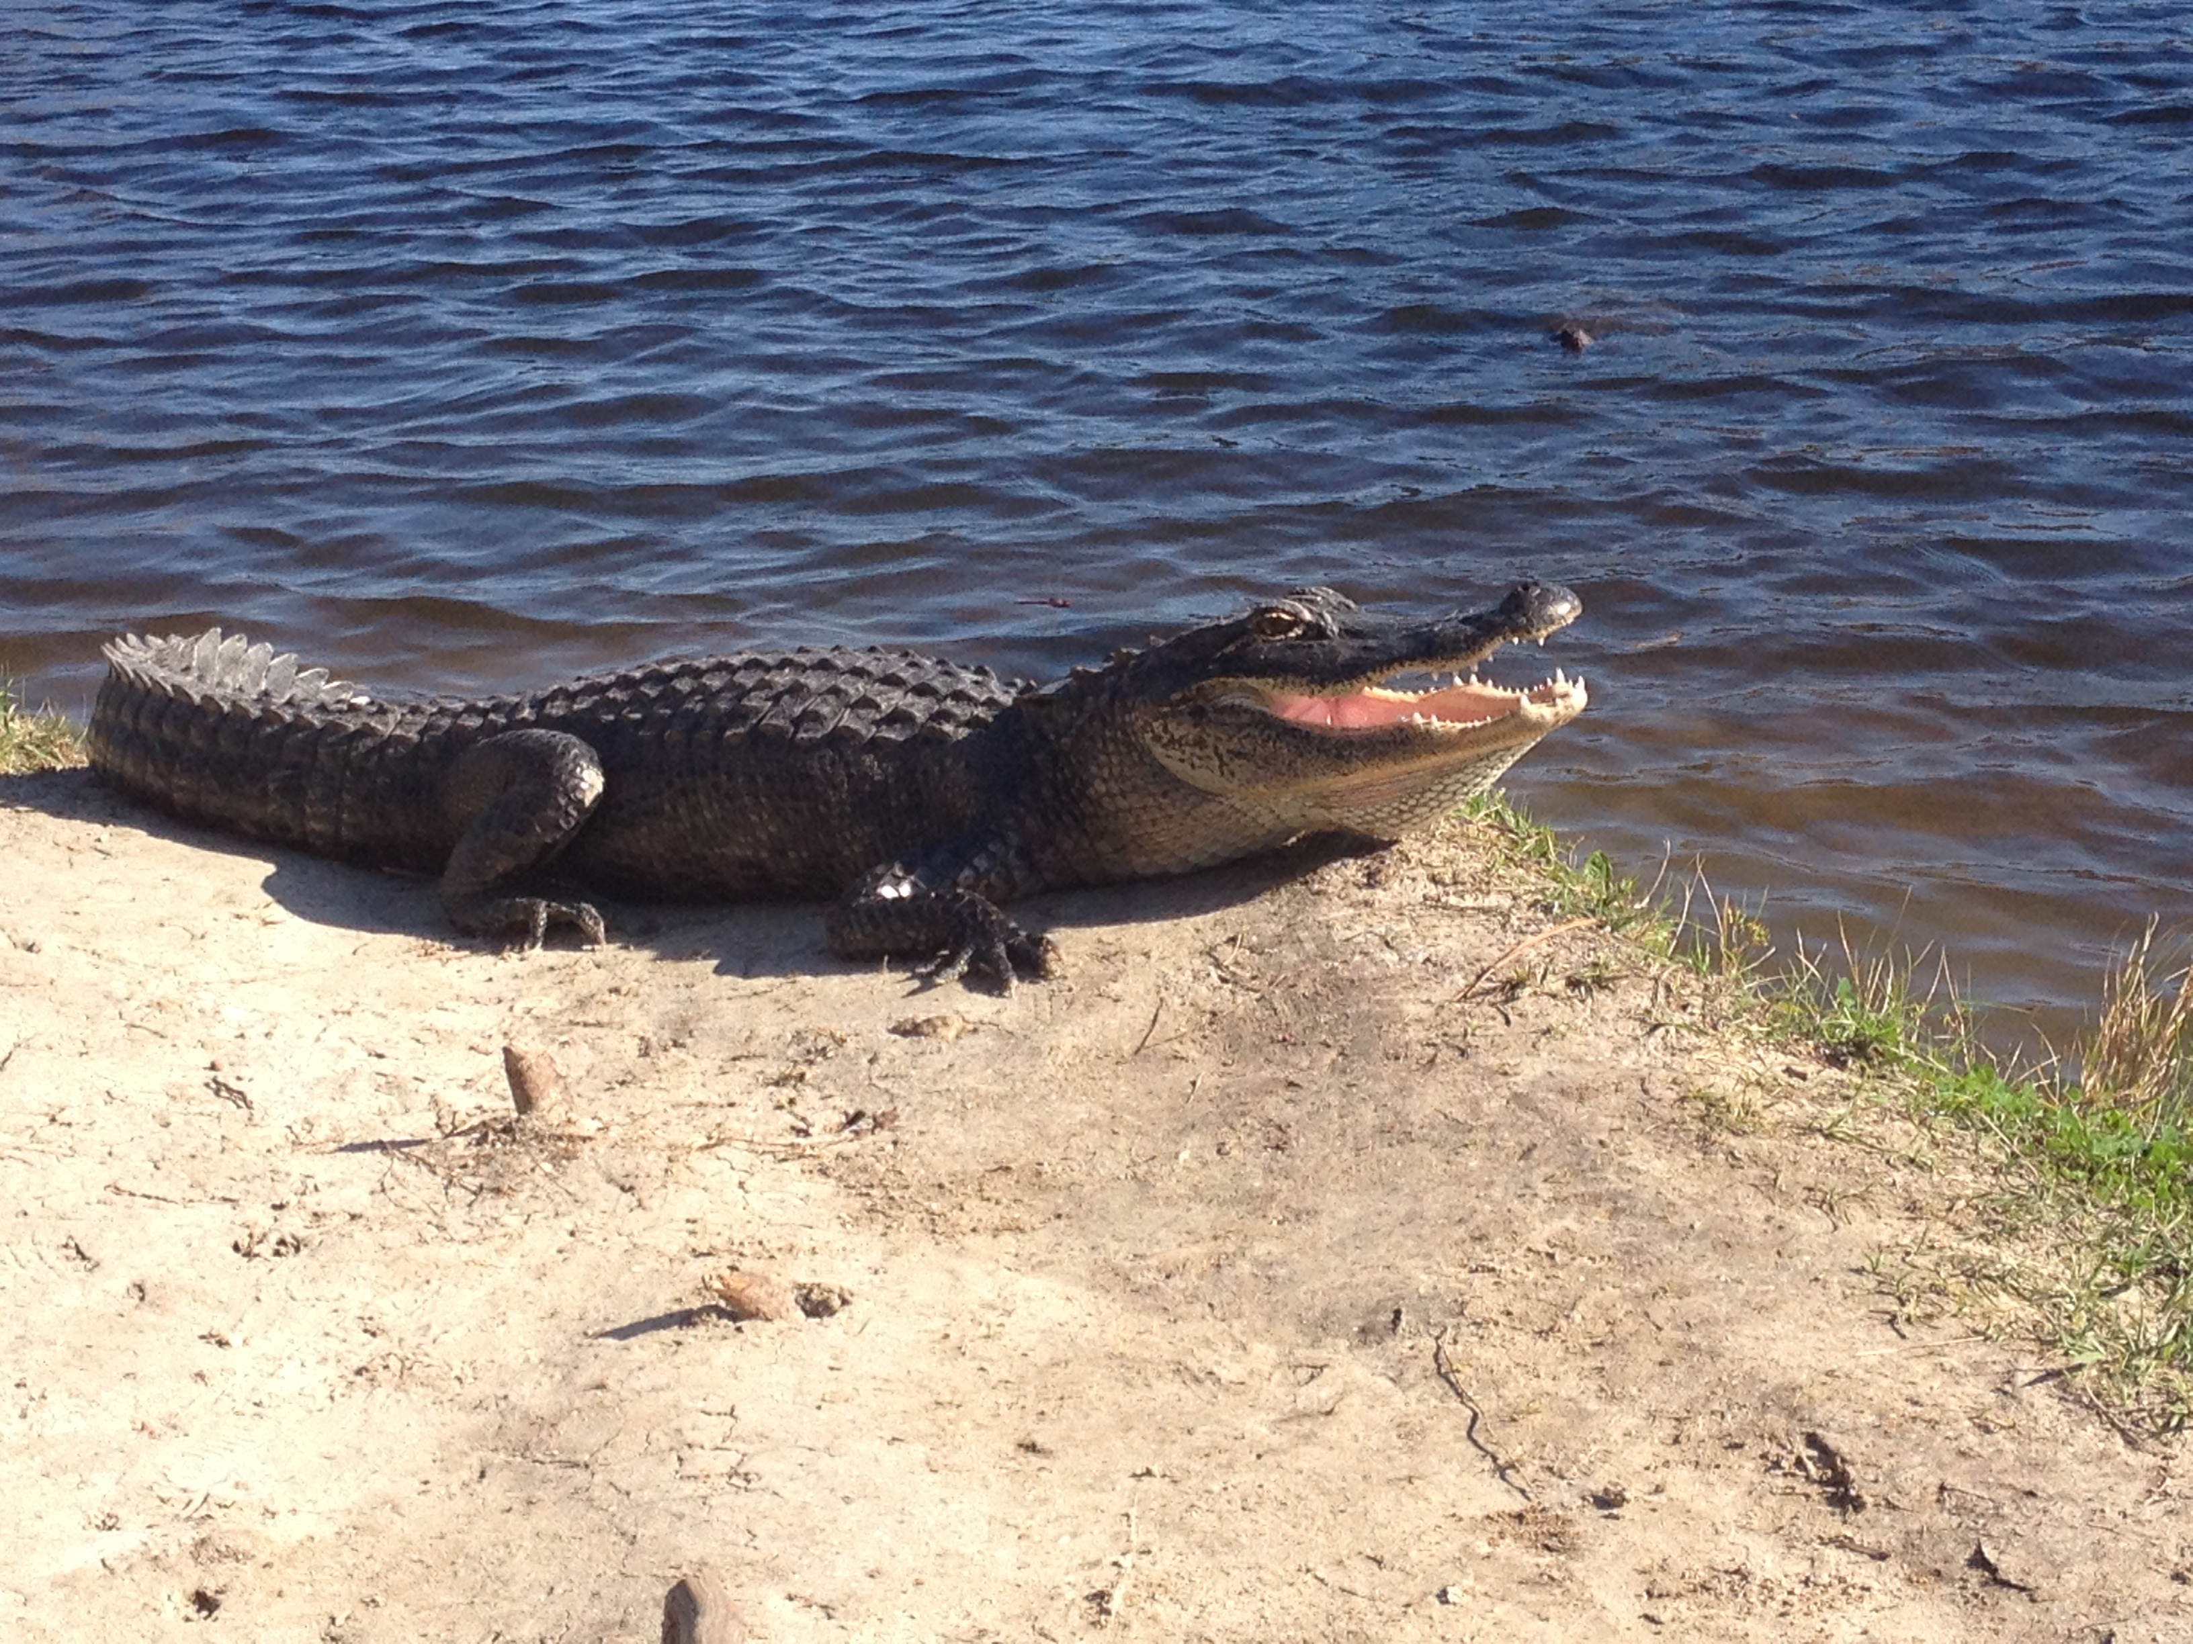
International Clinics on Infectious Disease, Dynamics, & Data
MMED: Clinic on the Meaningful Modeling of Epidemiological Data
May-June 2023, Cape Town, South Africa
DAIDD: Clinic on Dynamical Approaches to Infectious Disease Data
December 2023, Virtual
South African Center for Epidemiological Modeling and Analysis (SACEMA), Director
Dr. Juliet Pulliam
University of Stellenbosch
www.ici3d.org

Slide 126
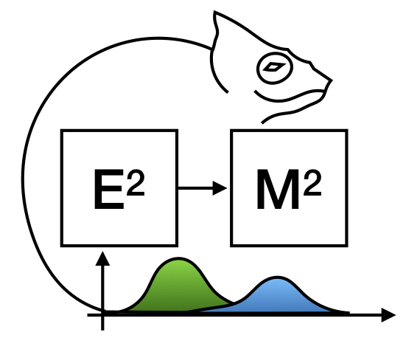
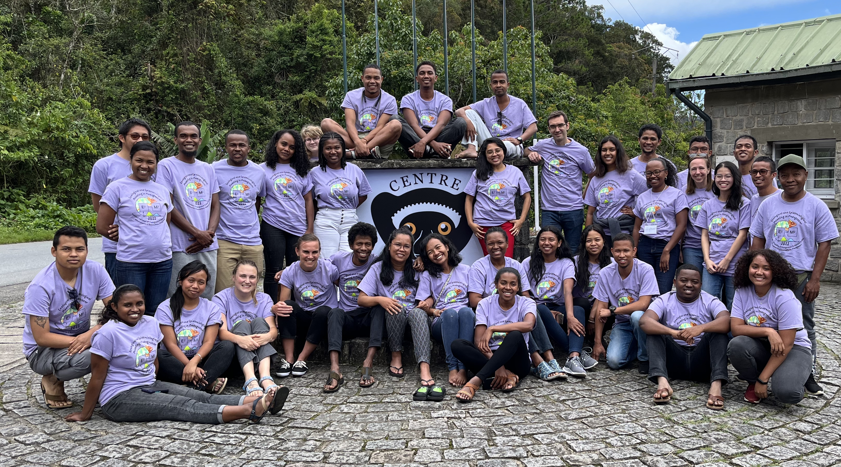
E²M²:
Ecological and Epidemiological Modeling in Madagascar
www.E2M2.org
Photo: January 2023, Ranomafana National Park, Madagascar
Next Clinic: March 2024, Mantasoa, Madagascar

